Slide 1
Docker

Slide 2
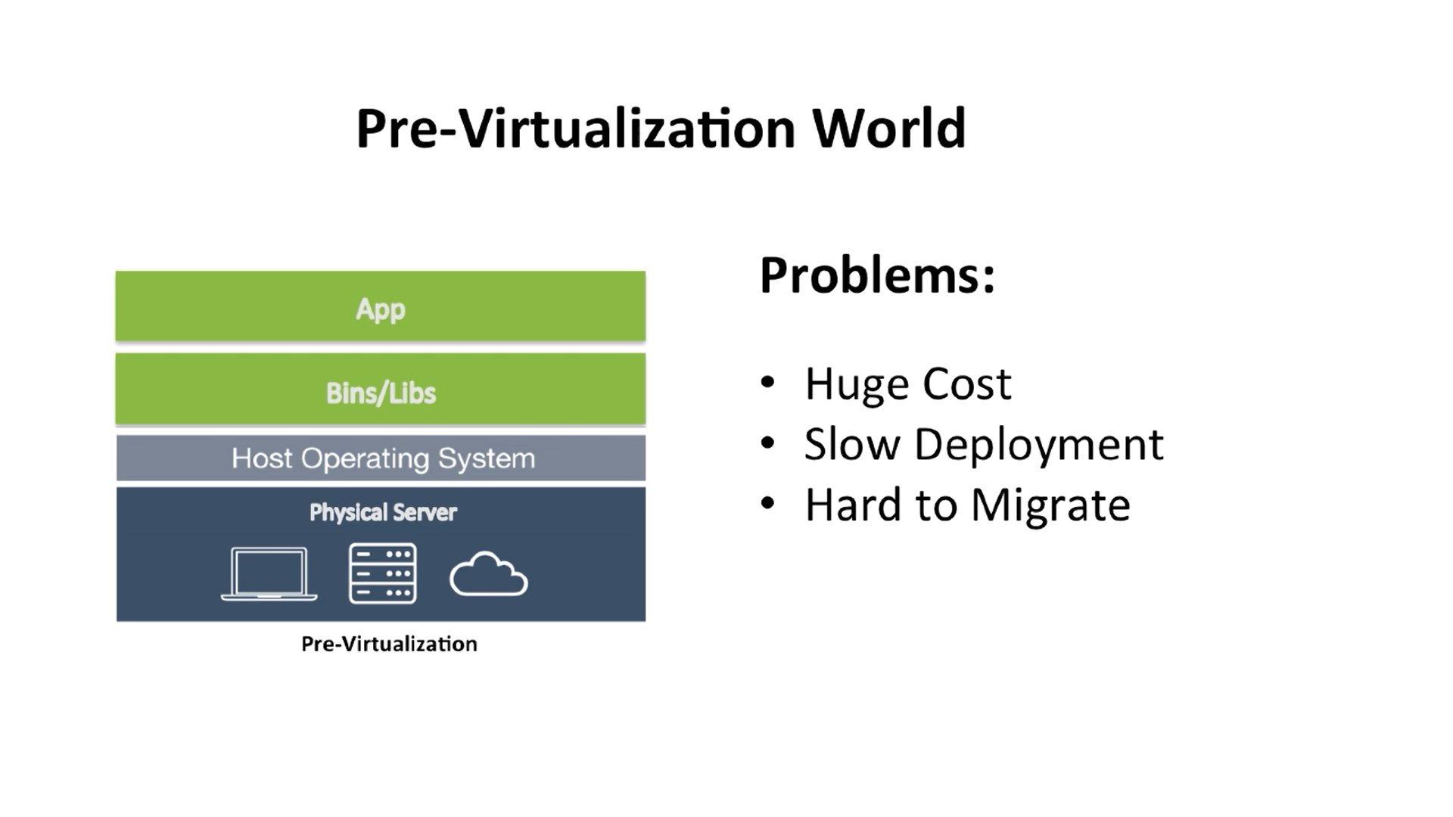
Virtualization (1)

Slide 3
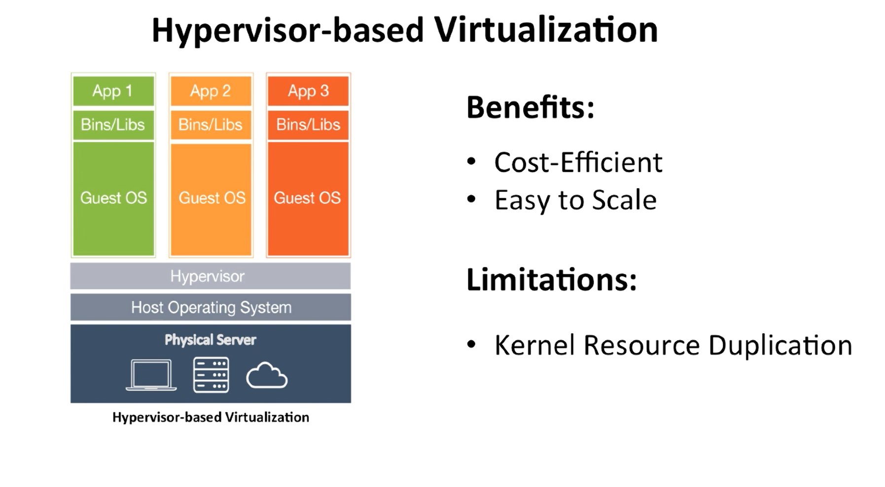
Virtualization (2)

Slide 4
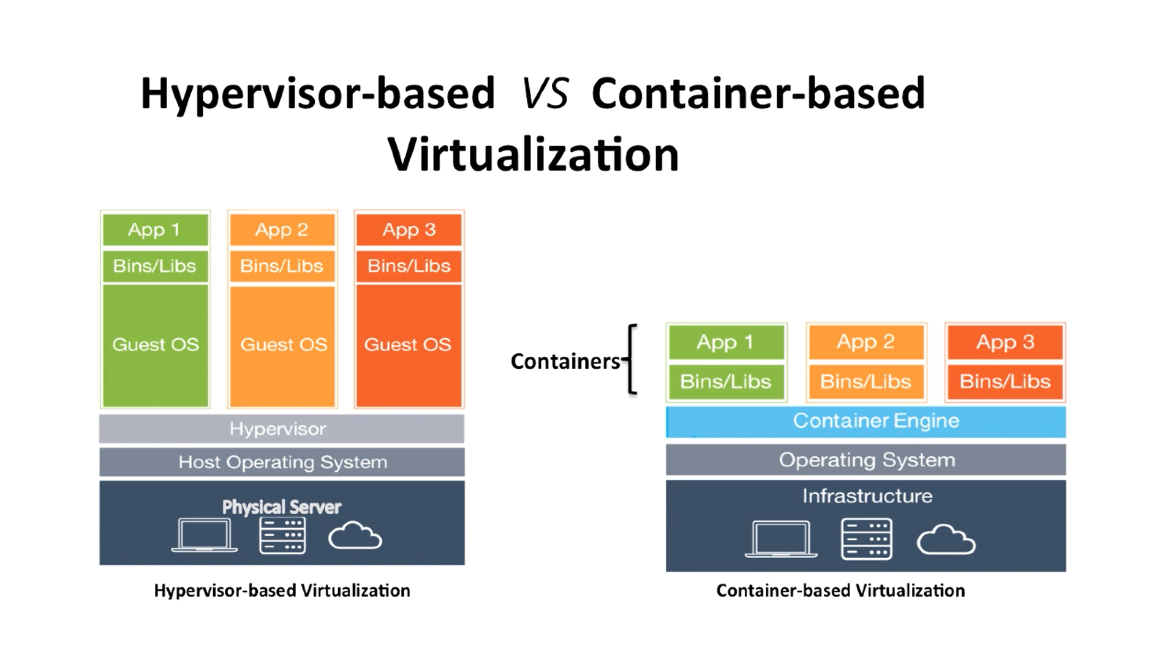
Virtualization (3)

Slide 5
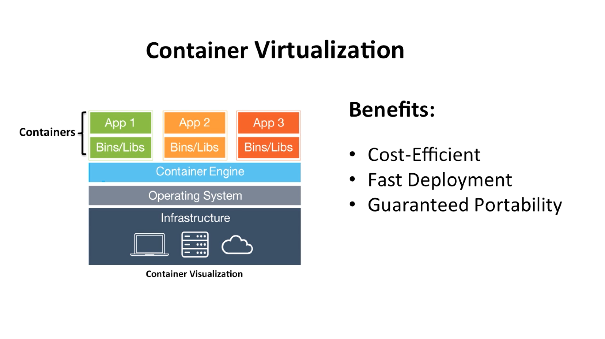
Virtualization (4)

Slide 6
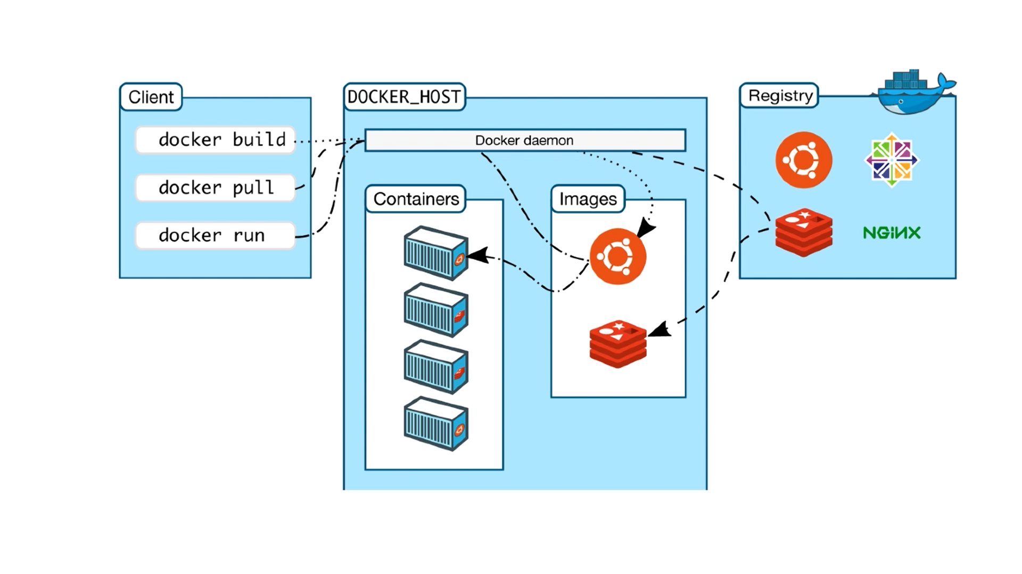
Client/Server

Slide 7
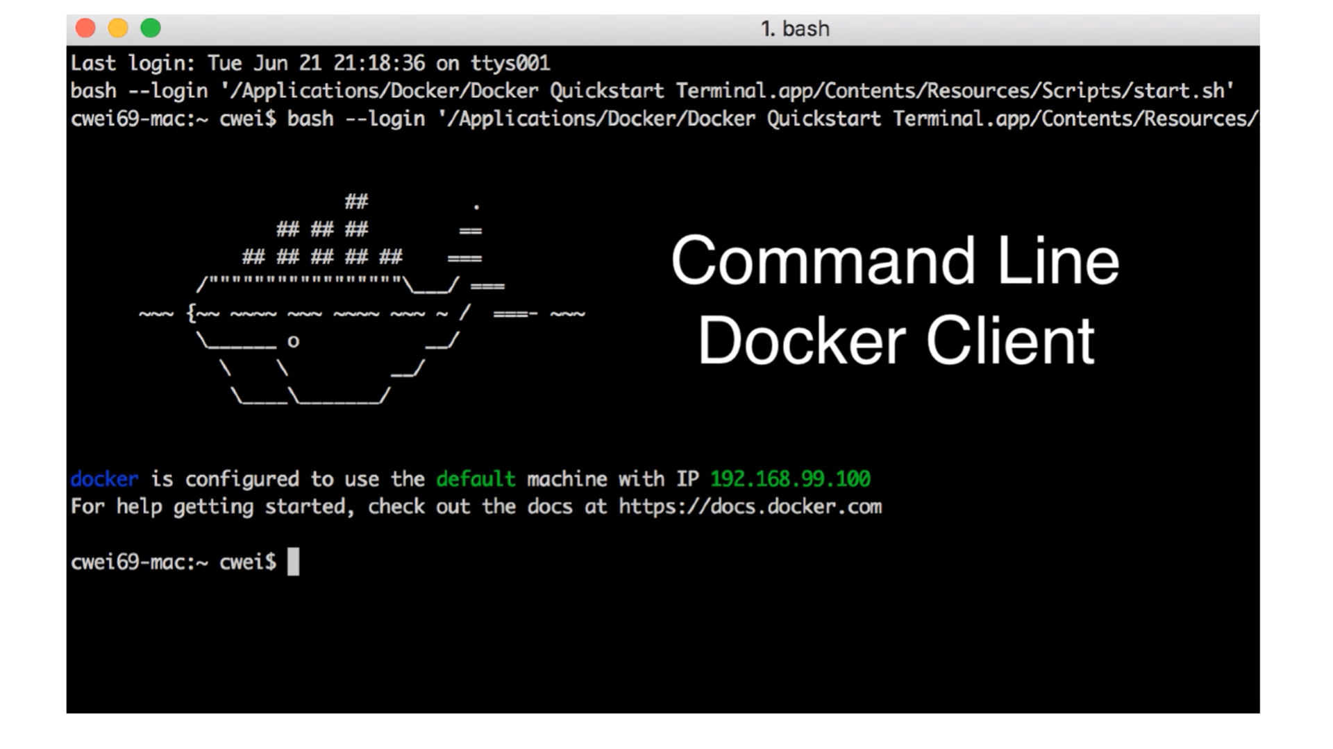
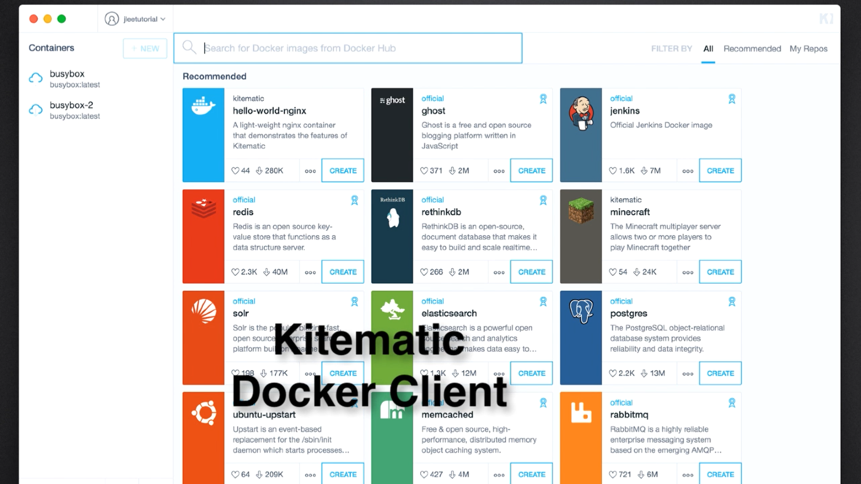
Client Interfaces

Slide 8
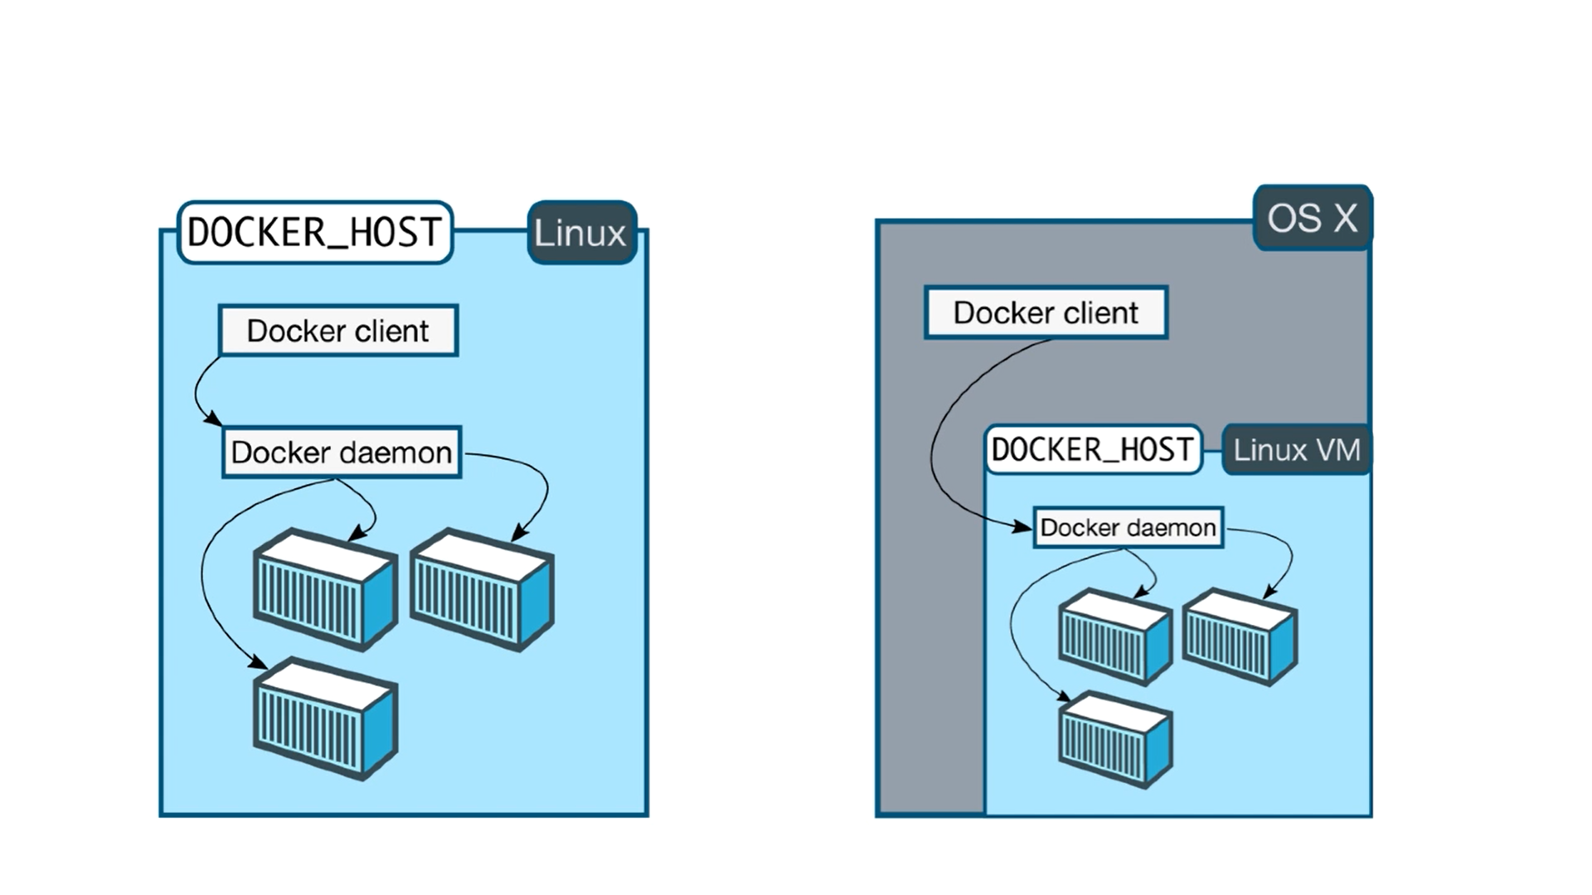
Only Linux Docker Host

Slide 9
Docker Client and Docker Toolbox
Docker Client
Docker Toolbox
Mac OS X 10.10.3 or newer
Windows 10 or newer
Mac older than OS X 10.10.3
Windows older than Windows 10
Needs VirtualBox
Not compatible with Hyper-V

Slide 10
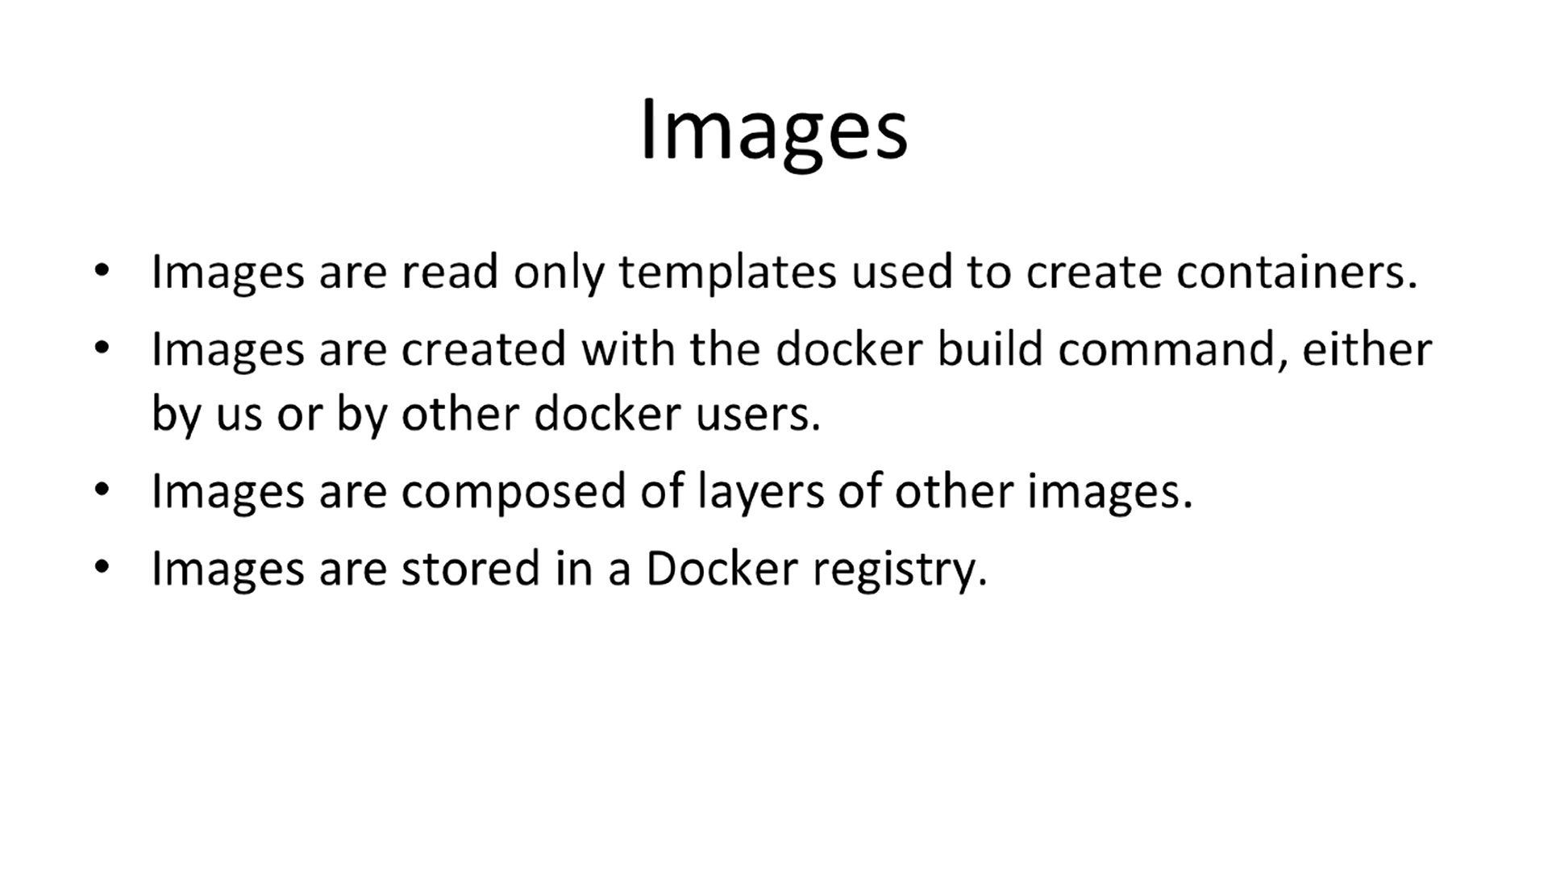
Concepts (1)

Slide 11
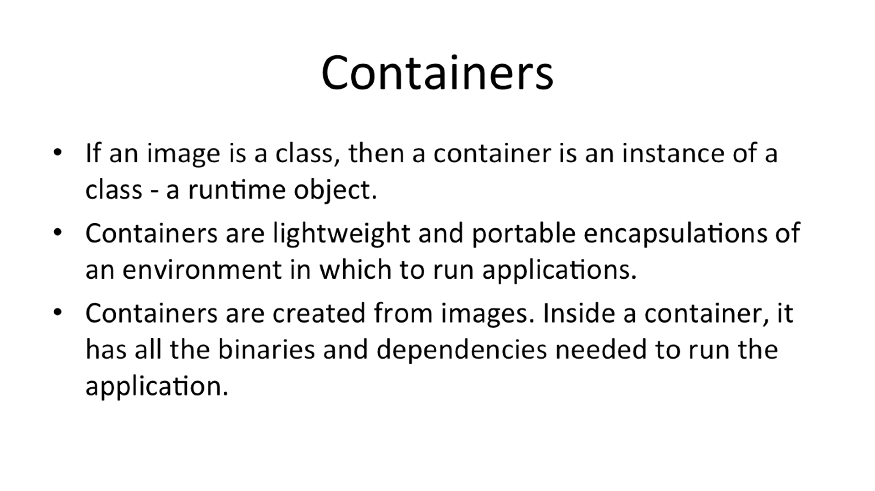
Concepts (2)

Slide 12
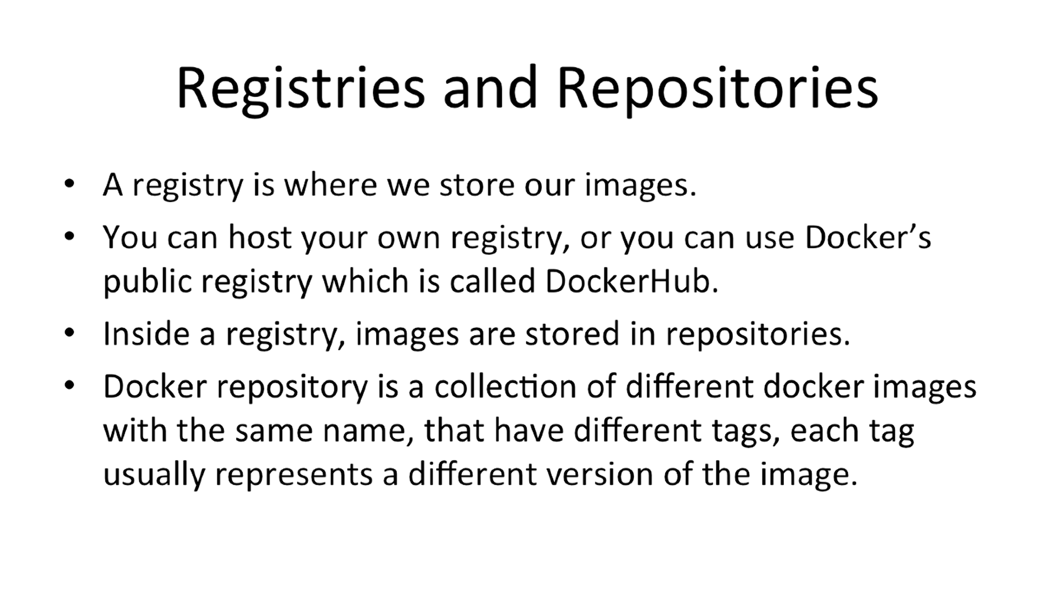
Concepts (3)

Slide 13
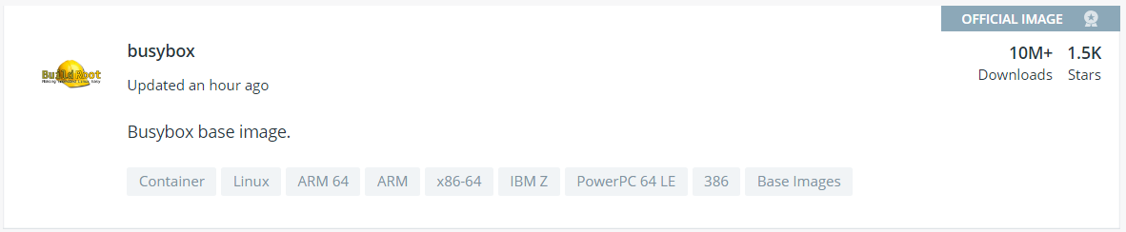
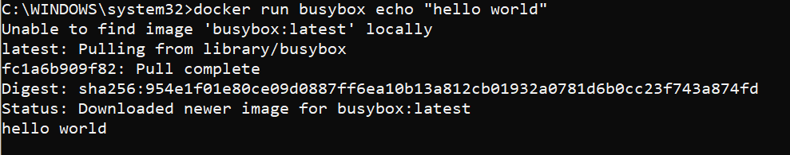

Hello World
Choose image on Docker HUB
Choose TAG
BusyBox
Commands
docker images
docker run busybox:1.24 [command]
=> echo «hello world»

Slide 14
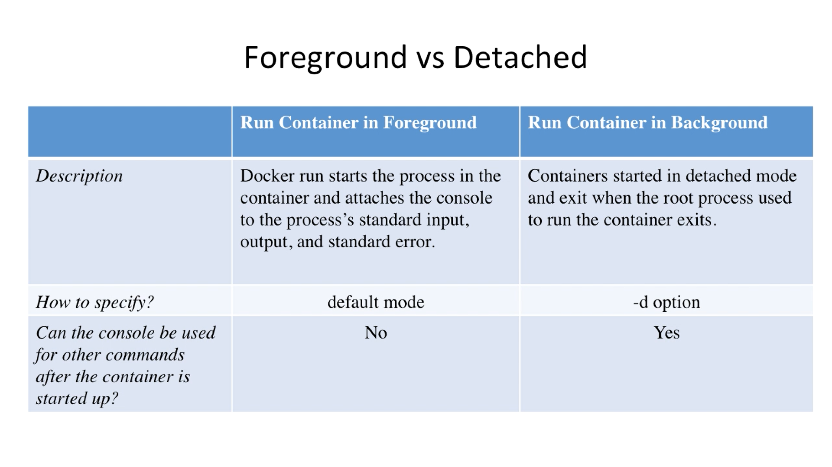
Containers

Slide 15



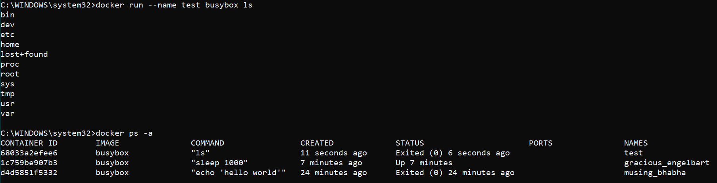
Examples

Slide 16
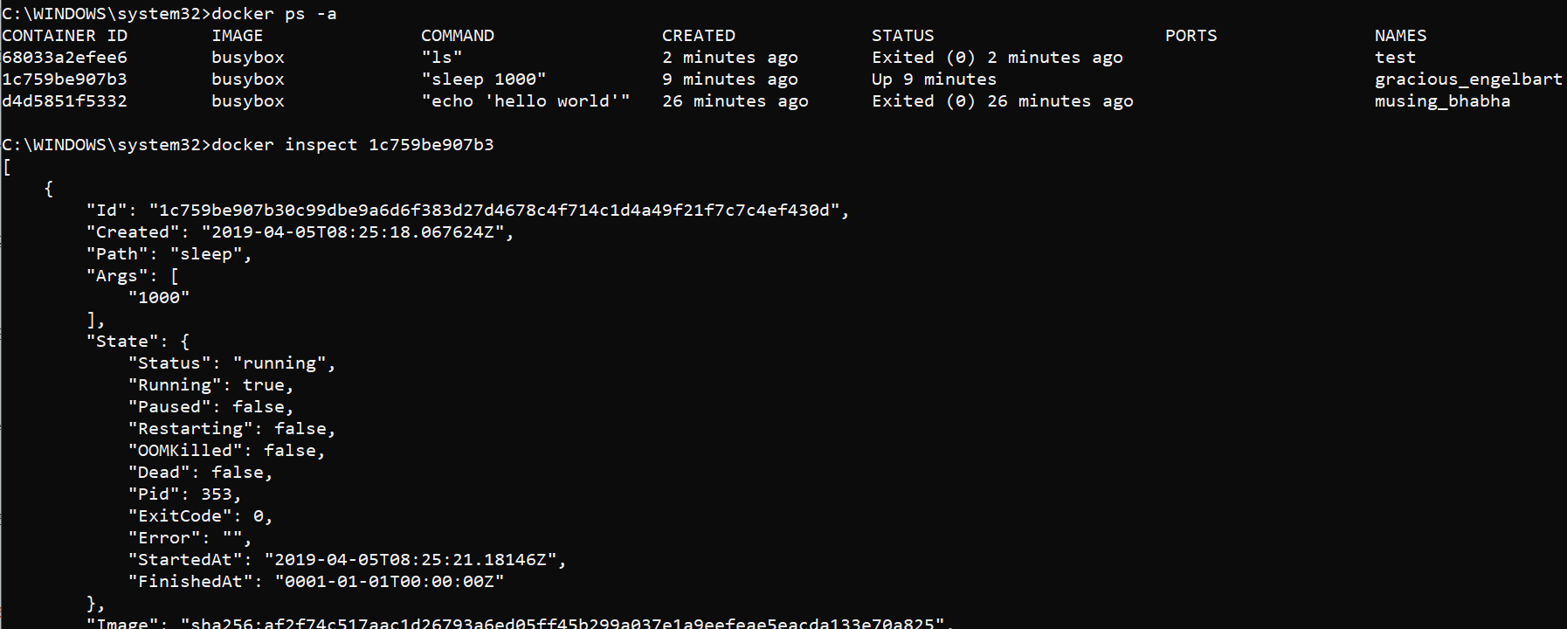
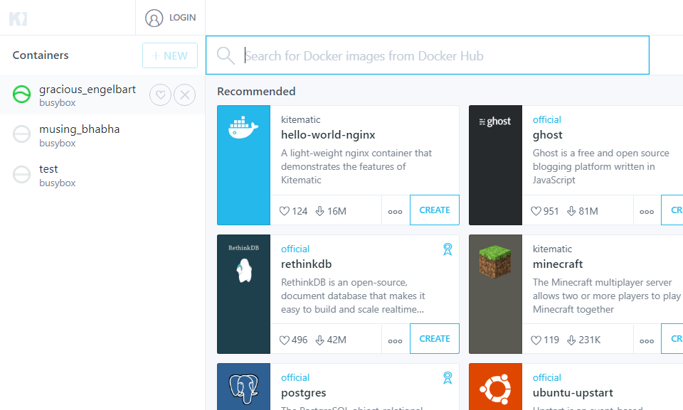
Inspect

Slide 17
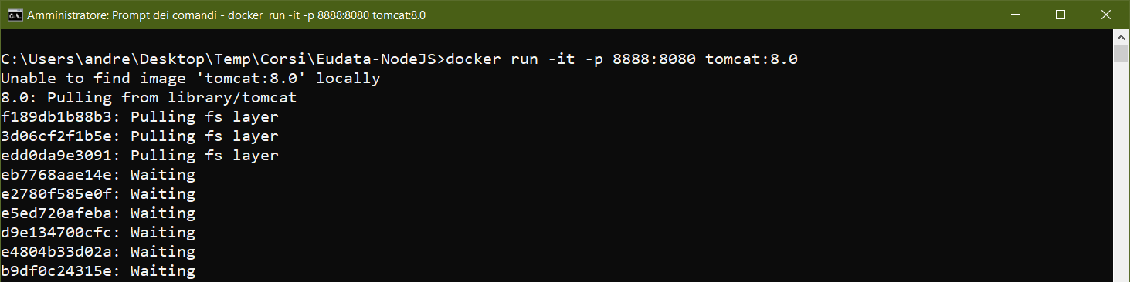
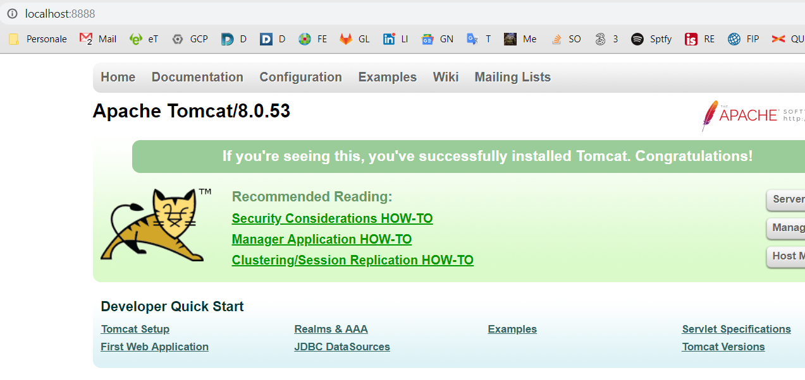

Port mapping

Slide 18

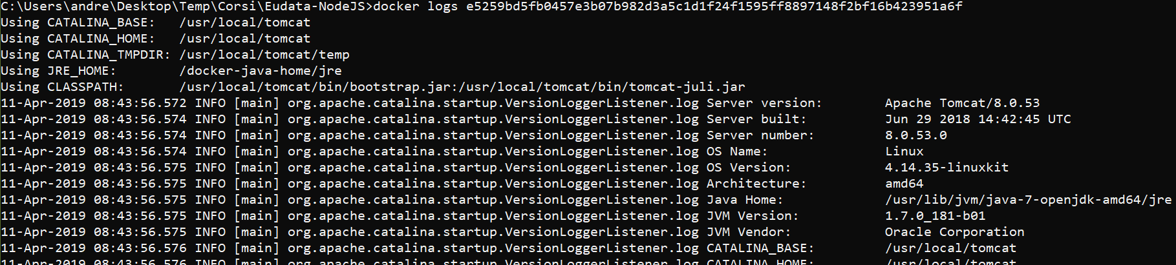

Logs in detached mode

Slide 19
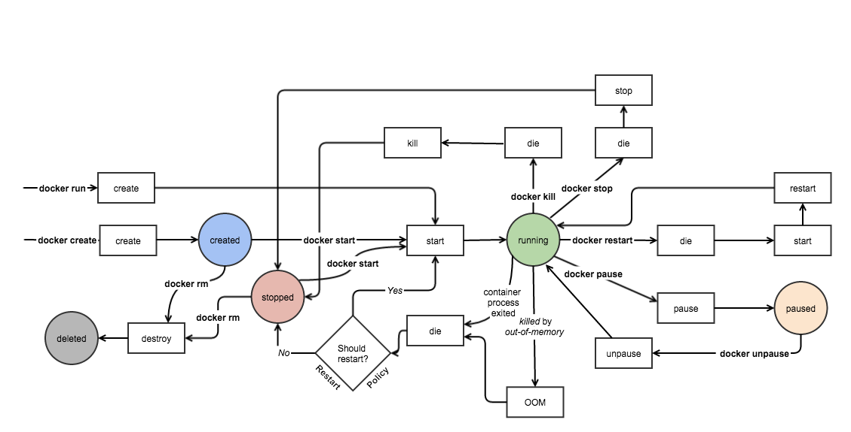

Slide 20
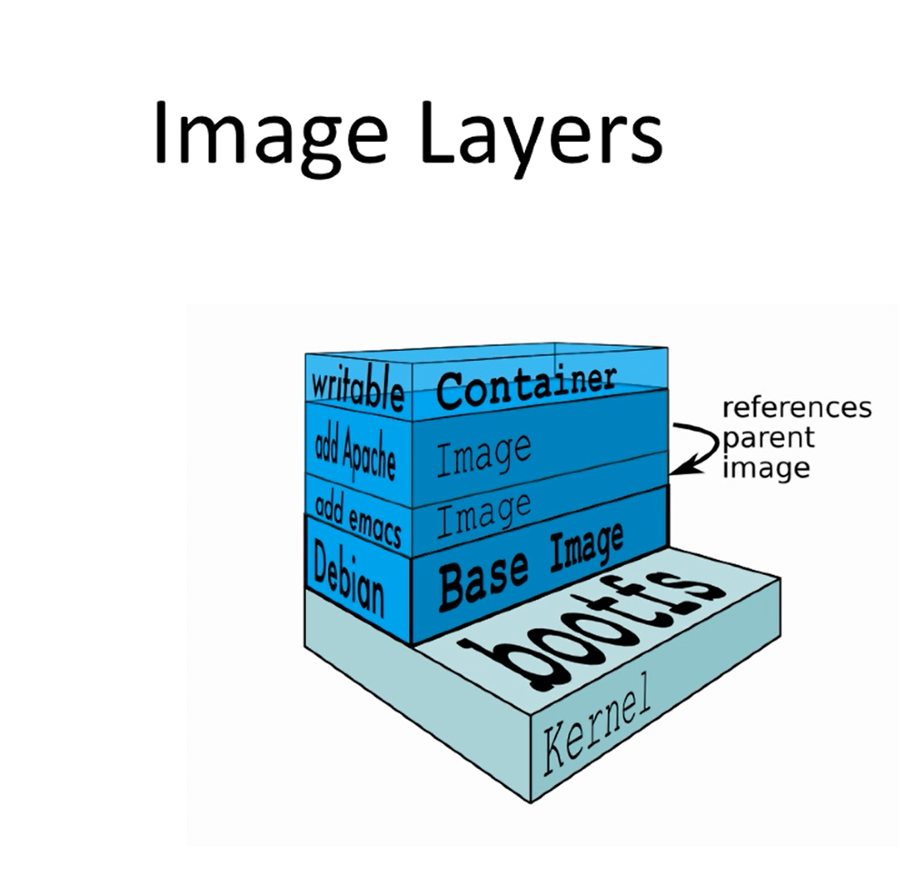
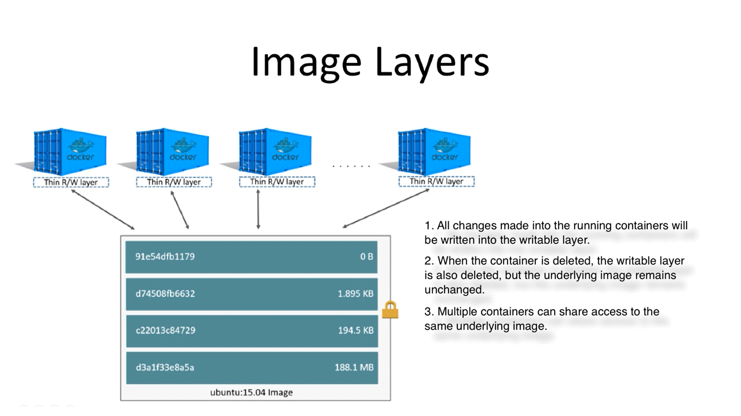

Docker image layers

Slide 21
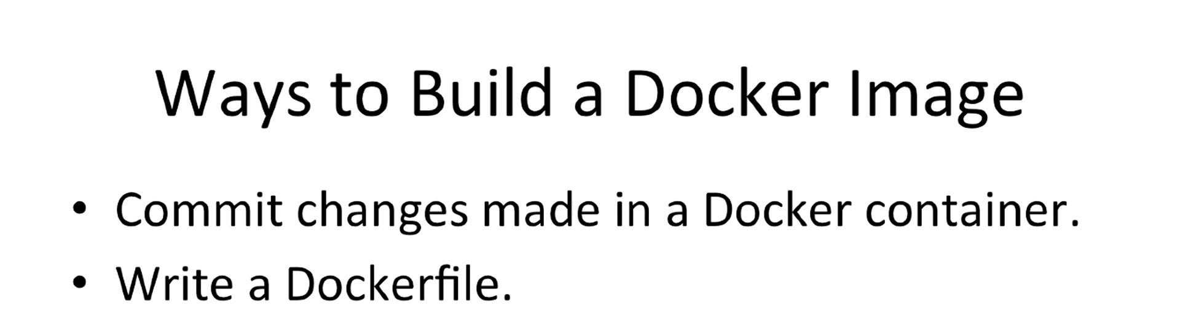
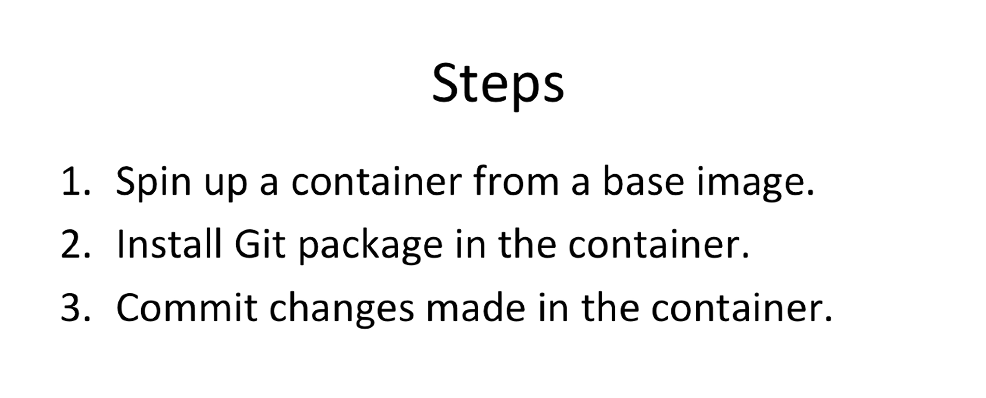
Build a docker image

Slide 22
